Slide 1

The
Mike Levey,
Johnathan Perrier,
Josh Spain
James Simson
… And Mike

Slide 2
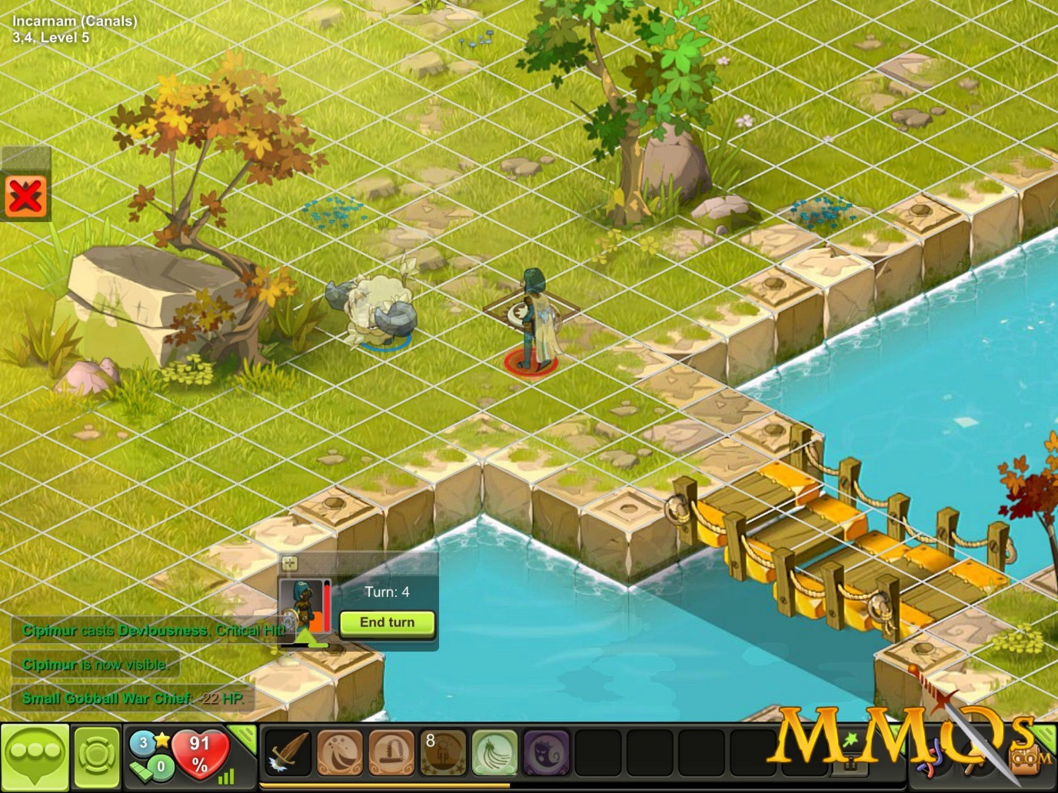
Description of Product
A website to share stats and strategies
We used the Dofus as our test case
Discuss anything related on the forum
Observe trends and make groups with other members

Slide 3
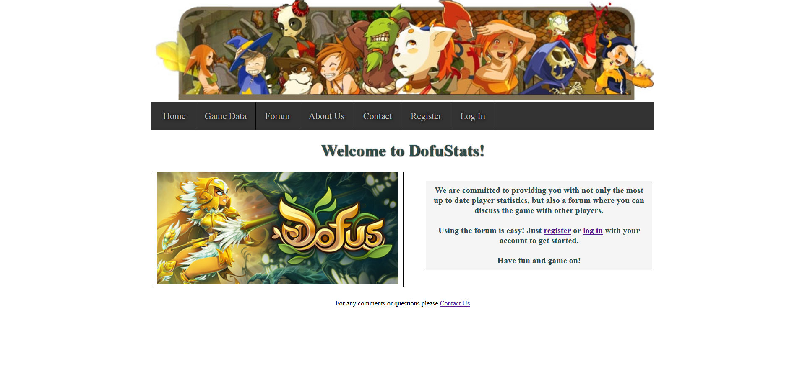
Requirements
Users be able to view player characters statistics from the game Dofus
Users can create their own account to post stats and discuss things on the forum
Relatively easily navigable website

Slide 4
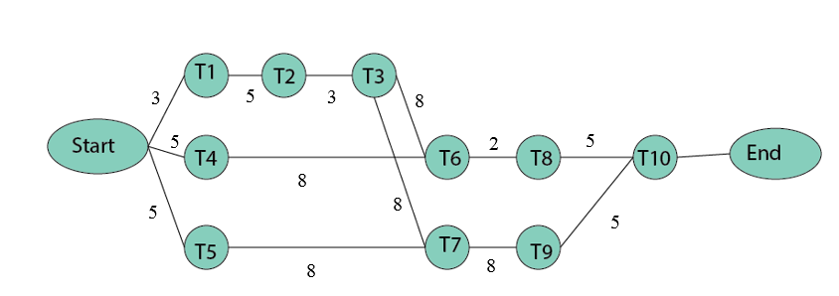
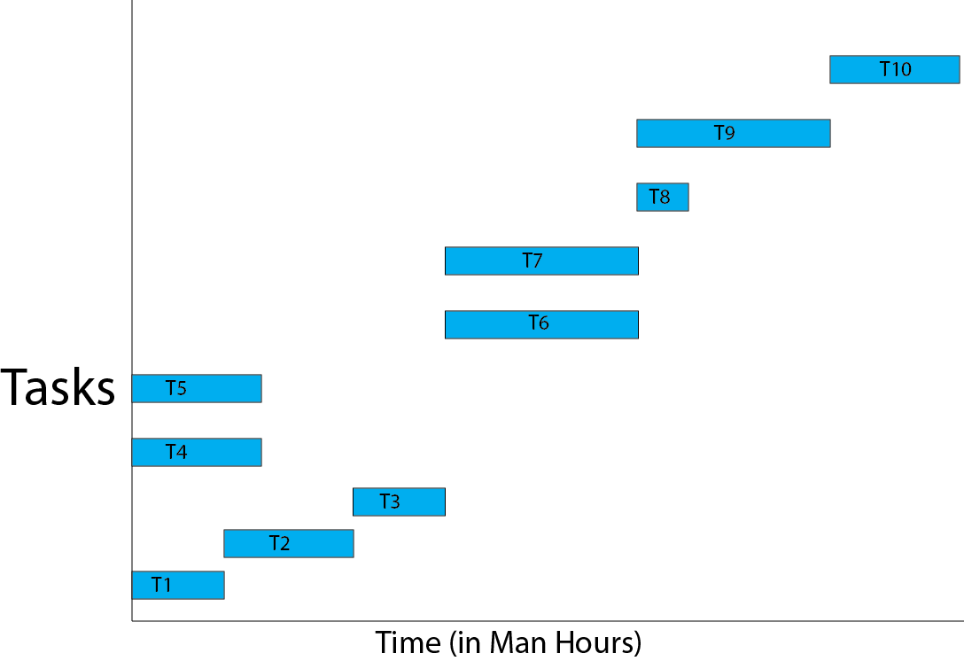
Analysis Models
CPM Chart
GANNT Chart
T1- Web Design/Plan
T2- Art
T3- Implement Website
T4- Design Stats Database
T5- Design User Database
T6- Implement Stats Database
T7- Implement User Database
T8- Populate Stats Database
T9- Populate User Accounts
T10- Testing

Slide 5
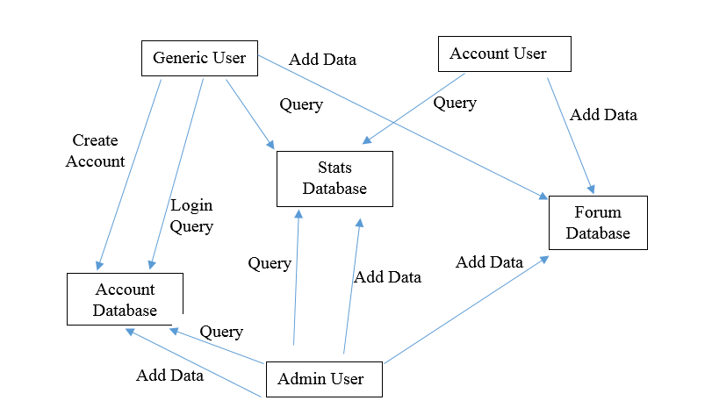
Analysis Models cont.
Data Flow Diagram

Slide 6
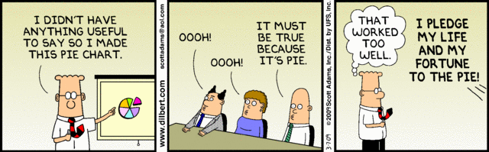
High Level Abstraction
Database Centric: All data will be added to database and called from the database when we need it
Game Stats Database
User Information Database
Forum Database

Slide 7
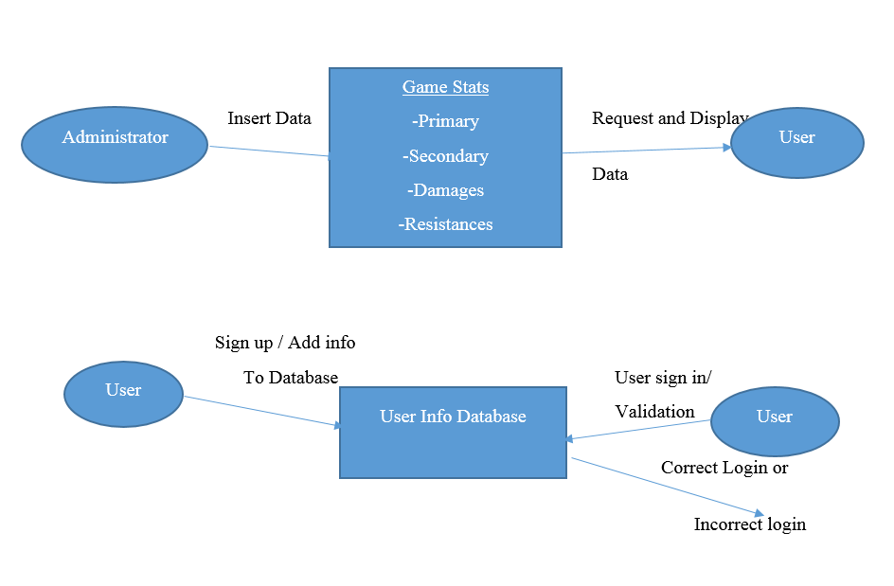
Low Level Abstraction

Slide 8
Here’s the Demo
Click this link to go to our website:
http://satoshi.cis.uncw.edu/~jap4983/DofuStats/index.php

Slide 9


Problems and/or Challenges
Finding time(s) for our team to meet up
Learning HTML/PHP
Getting in touch with each other

Slide 10

Q & A

